Slide 1
AB TEST: Instacart Shopper Hiring Problem
2025/03/28
Author: Kevin Xu

Slide 2
Exploratory Data Analysis
The dataset contains 21,698 applicants, with application_id ranging from 10001 to 31698.
The experiment was conducted over a period of 42 days, from 2018/10/01 to 2018/11/11.
Applicants were randomly assigned to one of two groups: control or treatment.
The control group had slightly fewer than twice the number of applicants compared to the treatment group.
No missing values were found after thorough inspection.

Slide 3
Data Cleaning
To avoid bias from participants who applied too late to reasonably complete the funnel, we removed applicants who joined near the end of the experiment.
The filtering threshold was based on the 95% confidence interval lower bound of the duration (in days) from application date to first batch completed date, calculated separately for each group.
Lower Bound of 95% CI: 9.9 days for control group, and 6.8 days for treatment group
On average, applicants in the control group took three more days to complete the funnel compared to those in the treatment group.
Specifically, any applicant whose application started after (experiment end date − group-specific lower bound) was excluded from the analysis.
After data cleaning, 16,224 applicants remained.

Slide 4
AB Test
Based on the cleaned data, the conversion rates are:
Control Group: 26.3%
Treatment Group: 41.3%
With a large sample size, we can conduct a Z-test to compare the conversion rates between the control and treatment groups, using the unpooled standard error.
The hypotheses were:
H0: conversion_rate_control = conversion_rate_treatment
Ha : conversion_rate_control > conversion_rate_treatment
The Z-score was 19.22 and the p-value was effectively 0, providing strong evidence against the null hypothesis.
The 95% confidence interval for the conversion rate difference is [13.41%, 16.45%], indicating the treatment group outperformed the control group by a significant margin.

Slide 5

Among all applicants who initiated the background check, the conversion rates to first batch completion were: • Control group: 30.79% • Treatment group: 41.28%
The control group showed a significantly lower conversion rate compared to the treatment group.
As a result, the cost per successful conversion was also higher in the control group: • Control: $97.44 • Treatment: $72.68
These results show that the treatment group outperformed the control group in both conversion rate and cost-effectiveness, making it the clearly more efficient approach.
Cost effective

Slide 6
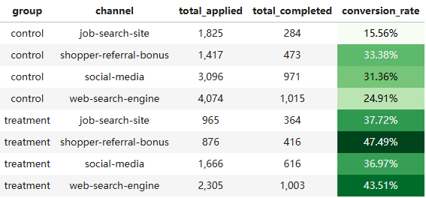
Additional Observations & Recommendations
Explored the relationship between application channel and conversion rate within both the control and treatment groups.
In both groups, conversion rates varied significantly by channel.
In the control group, the lowest conversion was from job-search-site (15.56%), while shopper-referral-bonus performed best (33.38%).
In the treatment group, all channels improved, with shopper-referral-bonus reaching a high of 47.49%.
The treatment effect was consistently positive across all channels, but the magnitude of improvement differed, suggesting interaction between group and channel.
Recommendation: The significant conversion rate improvement for job-search sites and web-search engines in the treatment group suggests that applicants from these channels may be more urgently seeking work. Compared to those from social media or referral programs, they are likely more sensitive to delays in the hiring process, benefiting more from the earlier background check step.

